Slide 1
Indications for liver transplantation in children
Biliary atresia – 55%
Cirrhosis/Cholestatic – 20%
  Alagille syndrome
  α1-antitrypsin deficiency
  Autoimmune/PSC
  Cryptogenic cirrhosis
Fulminant hepatic failure – 15%
Metabolic disorders – 5%
  Urea cycle defects
  Tyrosinemia
Primary hepatic malignancy – 5%

Slide 2
Liver Failure manifestations
Progressive deterioration in liver function
  Jaundice
  Poor synthetic function
    Coagulopathy (increased INR)
    Hypoalbuminemia
Portal hypertension
  Hypersplenism
  Variceal bleeding
  Ascites
Nutritional and growth failure

Slide 3
Recipient Conditions
Knowledge of etiology of ESLD
Assess hepatic vascular anatomy
Any contraindications to transplantation?
– Extrahepatic malignancy
Assess severity of disease (PELD/MELD)
Assess cardiopulmonary reserve
Manage complications of ESLD/portal HTN
Ensure normal childhood immunizations
Improve malnutrition
Aggressive treatment of possible infections

Slide 4
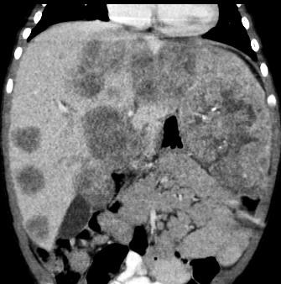
Liver lesions
Imaging for liver nodule characterization
Liver disease etiologies at increased risk for HCC
  Hereditary tyrosinemia
  Type 1 glycogen storage disease
  Type 2 progressive familial intrahepatic cholestasis
  Longstanding cirrhosis
Screening with AFP and U/S with cross-sectional imaging if concern Presence of liver lesion → listing, increased allocation priority
Hepatoblastoma
  Complete surgical resection is crucial for long-term survival
  Unresectable by conventional operation
→ liver transplantation
  Multidisciplinary care with oncology

Slide 5
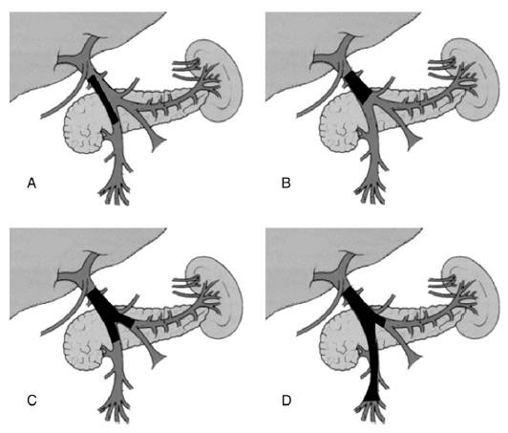
Portal Vein Thrombosis (PVT)
Common complication of cirrhosis, ESLD
  10% of patients undergoing liver transplantation
  Hypercoagulability, low flow state of PV, prothrombotic
mutations
Intraoperative challenges
  Pre-transplant cross- sectional imaging demonstrating PVT has implications on surgical approach
  Thrombectomy or alternative vascular reconstructions (interposition grafts)
Ponziani et al. Transpl Rev 2014;28:92-101.

Slide 6
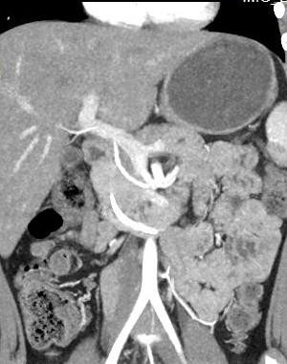

Replaced Hepatic Arteries
Small caliber native hepatic artery increases complexity in liver transplant
Variant hepatic artery anatomy coexists with small caliber native common HA
Higher rate of complications in recipients with variant arterial anatomy (21% versus 3%)¹
RHA in donor liver also adds complexity for reconstruction
¹Ishigami et al. AJR 2004;183:1577-1584.

Slide 7
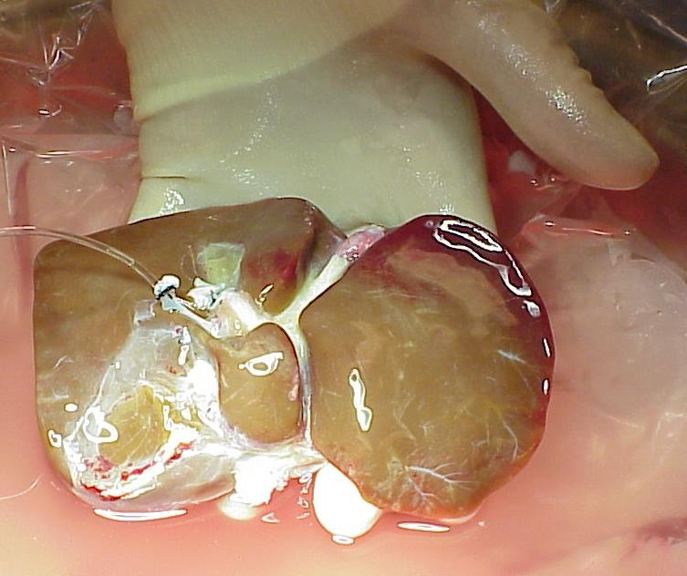
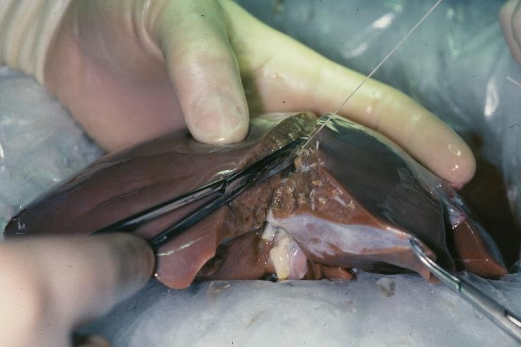
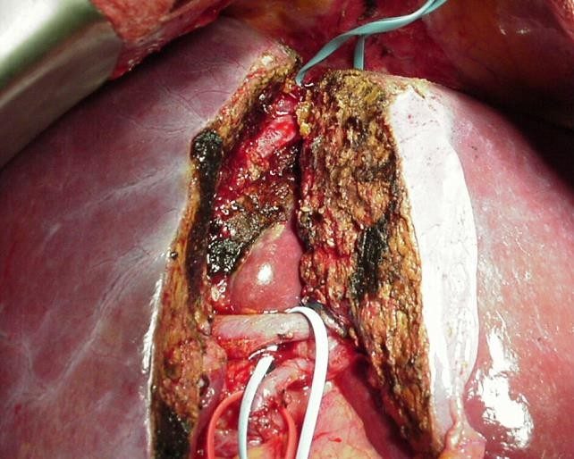
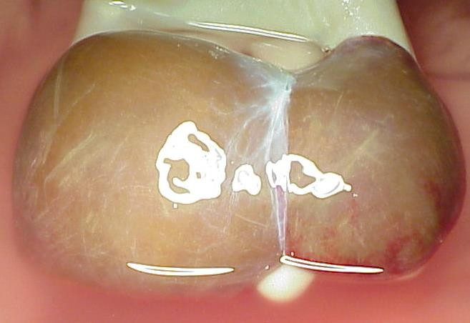
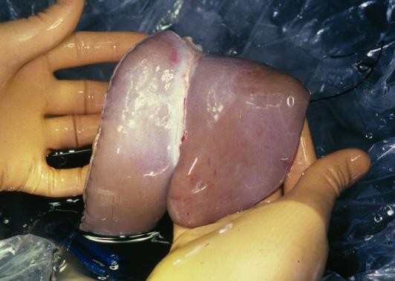
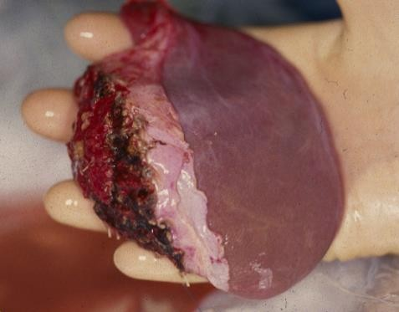
Types of donations
WHOLE
REDUCED SIZE
LD / SPLIT DD

Slide 8
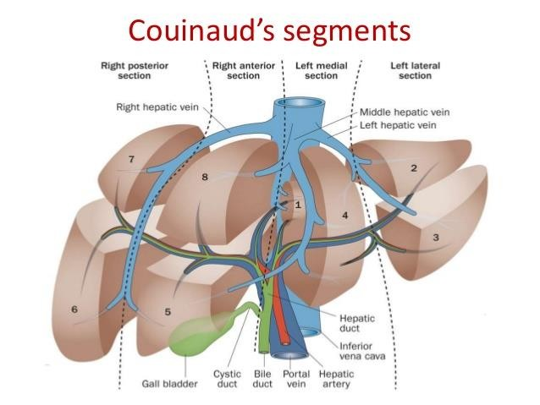
Liver Anatomy
https://www.slideshare.net/pankajkaira/radi ological-anatomy-of-hepatobiliary-system

Slide 9
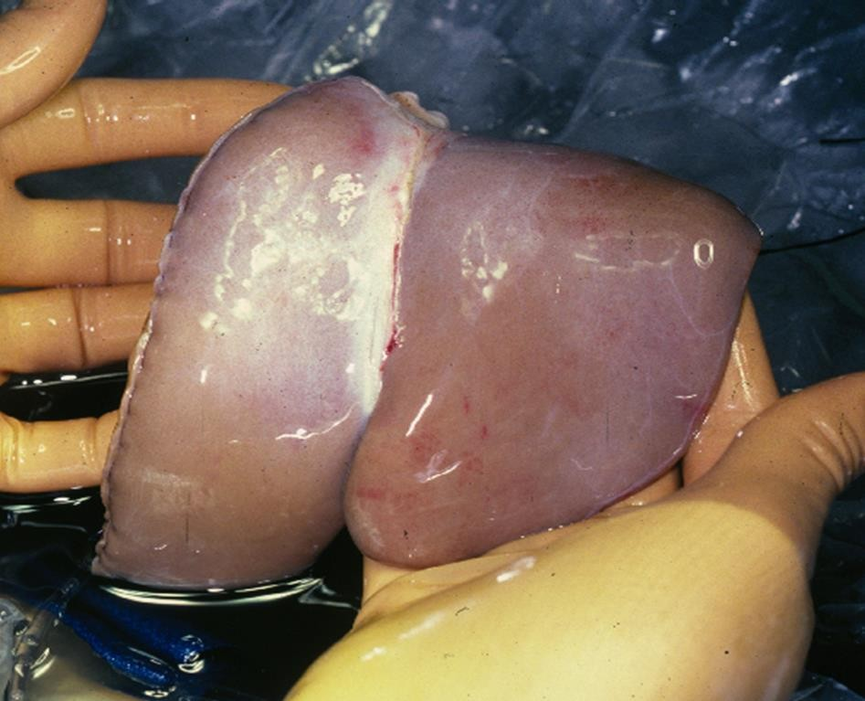
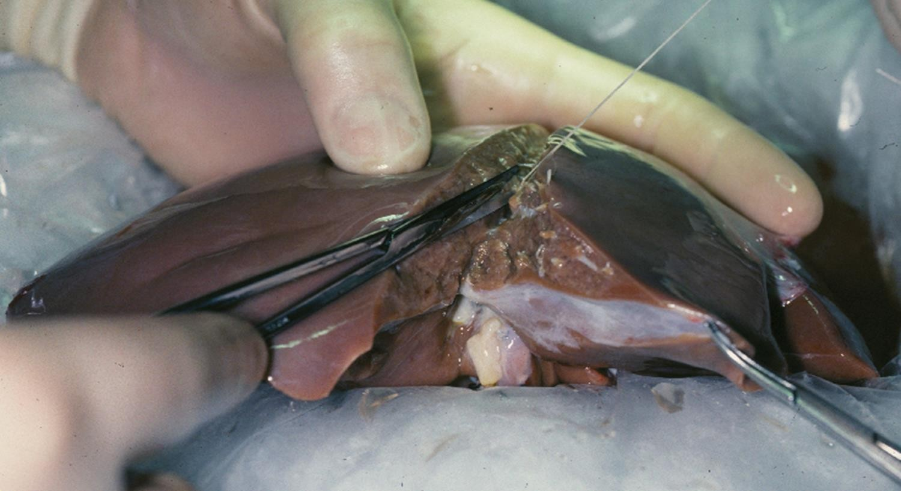
Reduced-size Liver Transplant
First described by Bismuth in 1984
  Excellent graft and patient outcomes
  Decreased waiting list mortality among children
Both deceased donor split liver transplantation (SLT) and living donor (LDLT) evolved from reduced-size liver transplantation

Slide 10
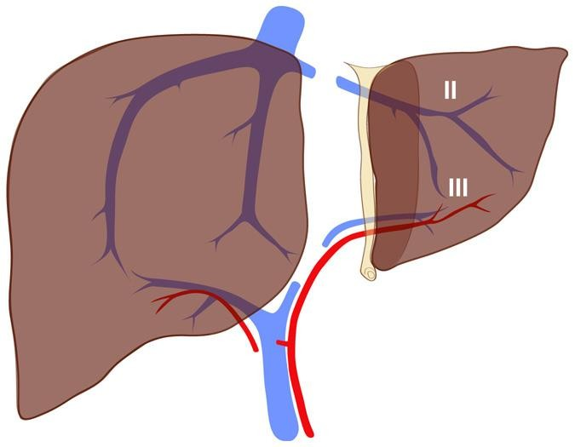
Left Lateral Section / Right Trisection

Slide 11
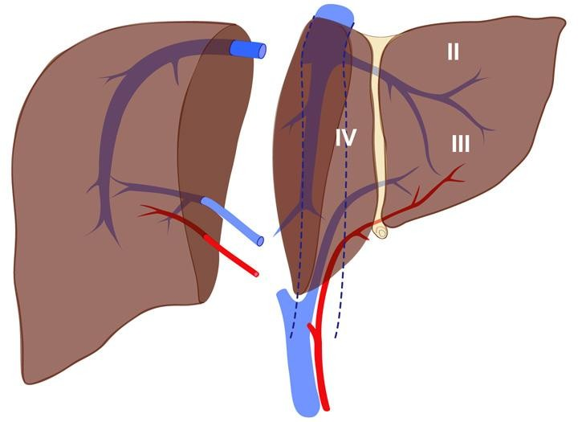
Left Lobe / Right Lobe Split

Slide 12
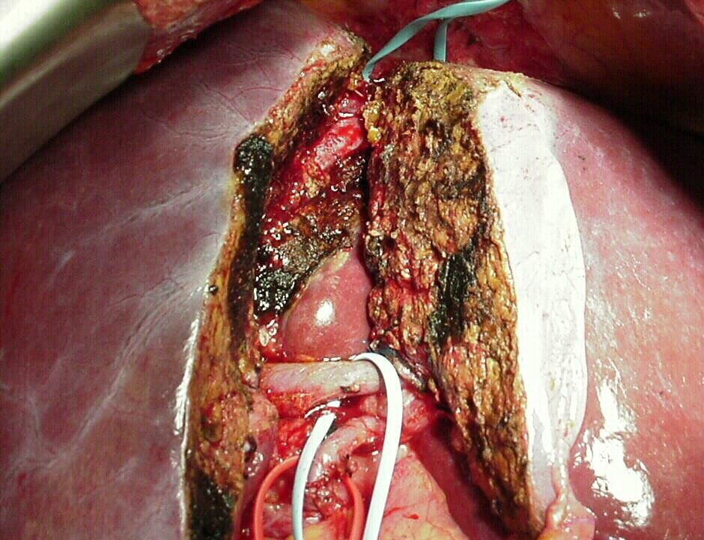
In Situ Left Lateral Section Dissection
Left Hepatic Vein
Middle Hepatic Vein
Left Portal Vein
Left Hepatic Artery

Slide 13
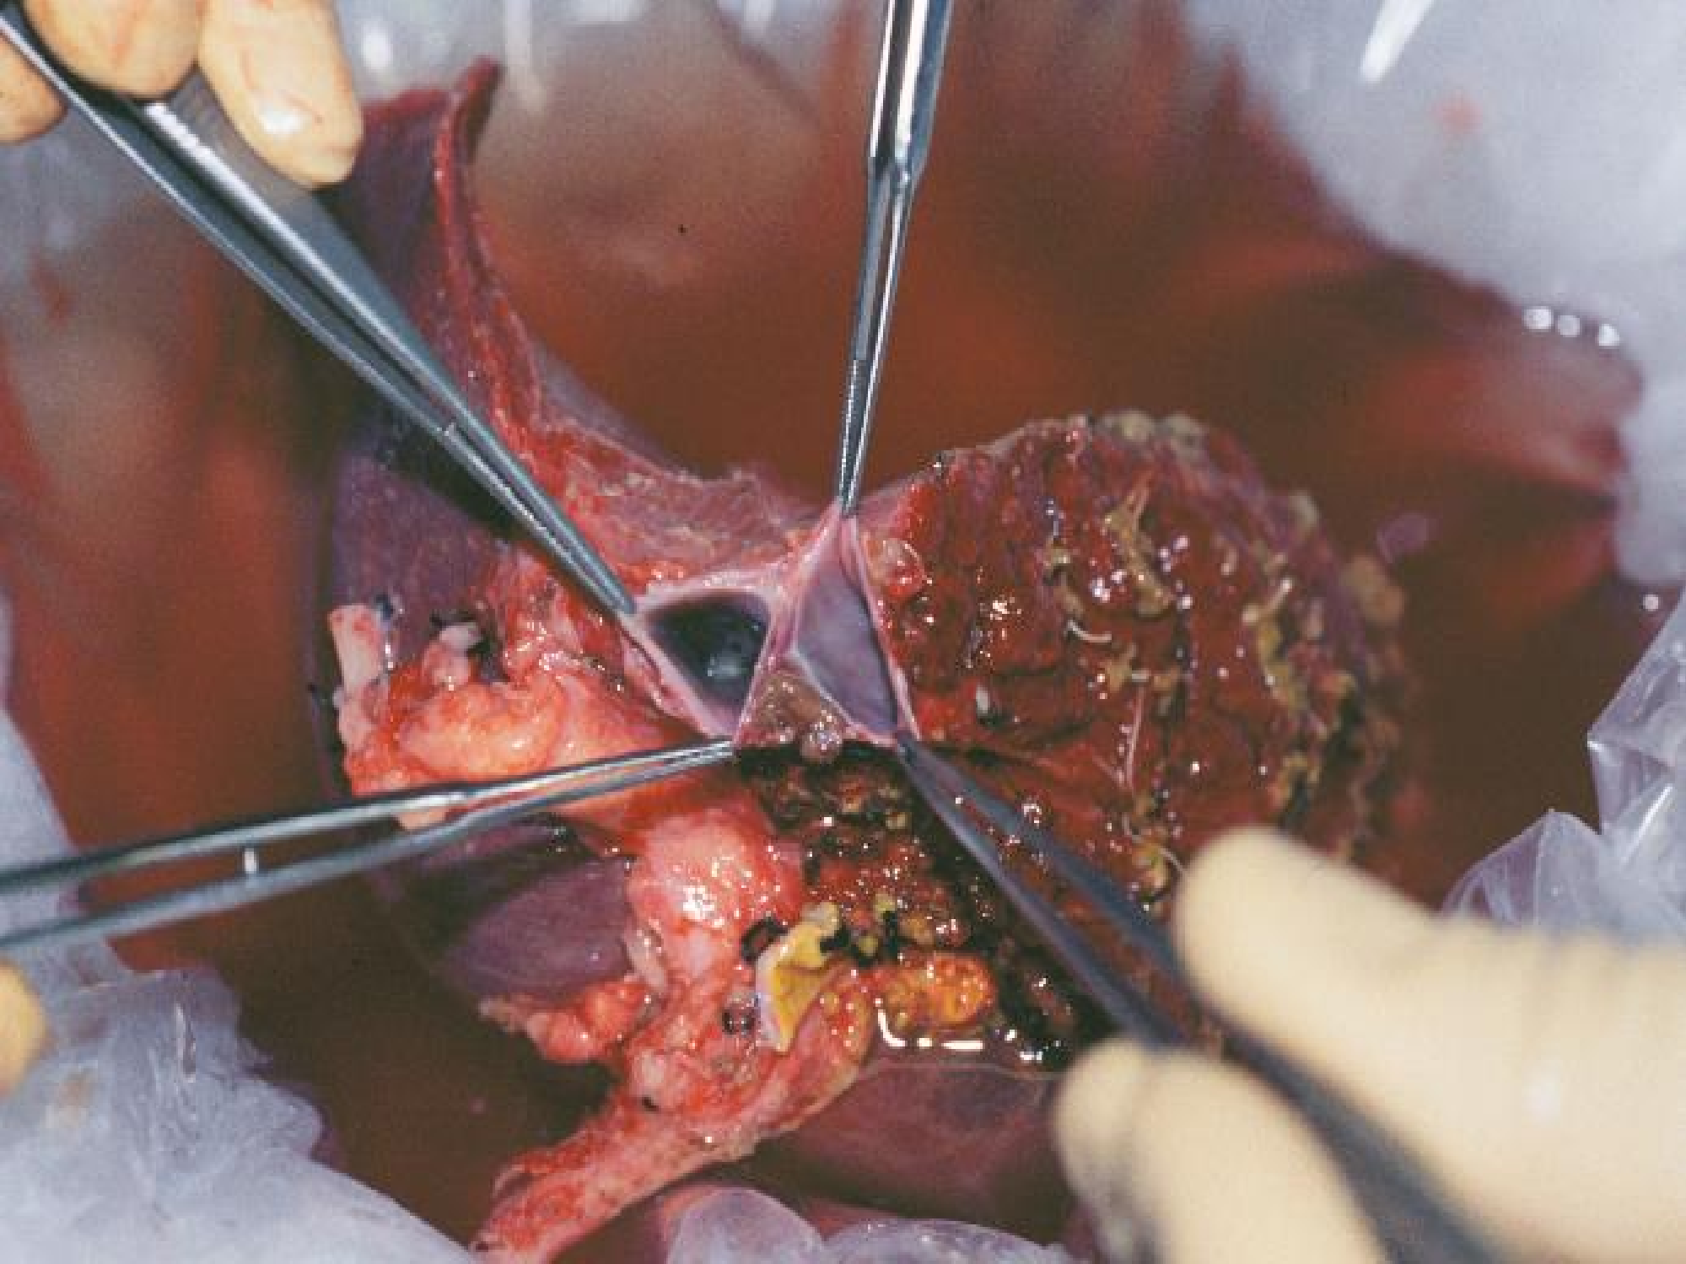
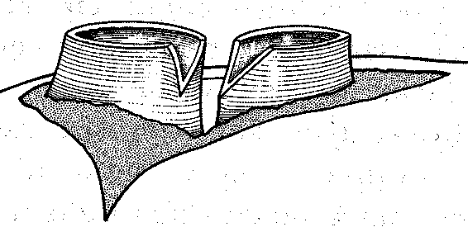
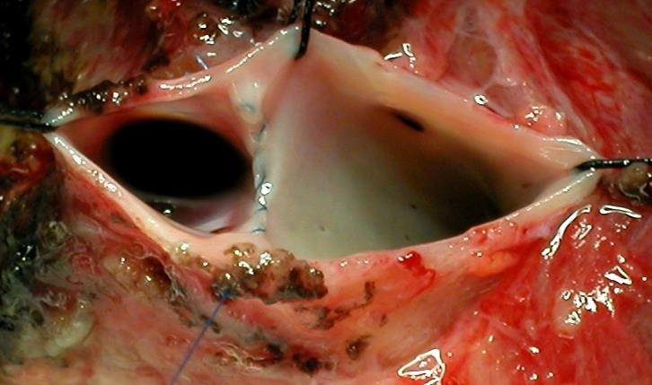

Slide 14
Allocation of Vessels and Biliary Tract
Cross-sectional imaging usually unavailable
Hepatic artery
  LLS / Right trisection split: ligation of prominent segment IV
artery may result in necrosis
Portal vein
Hepatic veins / Inferior vena cava
  Intraop ultrasound – allows delineation of major segment V and VIII hepatic veins draining into MHV
Bile duct
  Intraop cholangiography – mandatory for Right / Left split
Extra vessels for reconstruction
  Iliac artery and vein
  Others: Inferior mesenteric artery, carotid artery

Slide 15
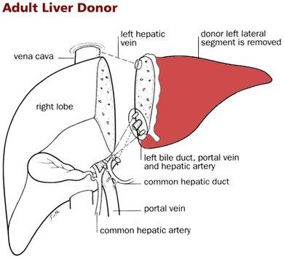
Living Donor Liver Transplant
http://www.surgery.usc.edu/hepatobiliary/pediatricsurgeryandtransplant.html

Slide 16
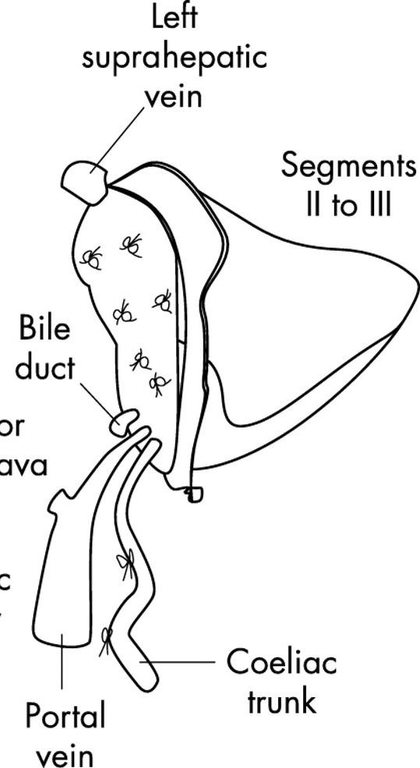
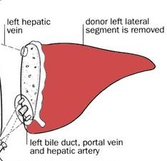
Living Donor vs. Split Liver DD
http://www.surgery.usc.edu/hepatobili ary/pediatricsurgeryandtransplant.html
Postgrad Med J 2004;80:571–576.

Slide 17
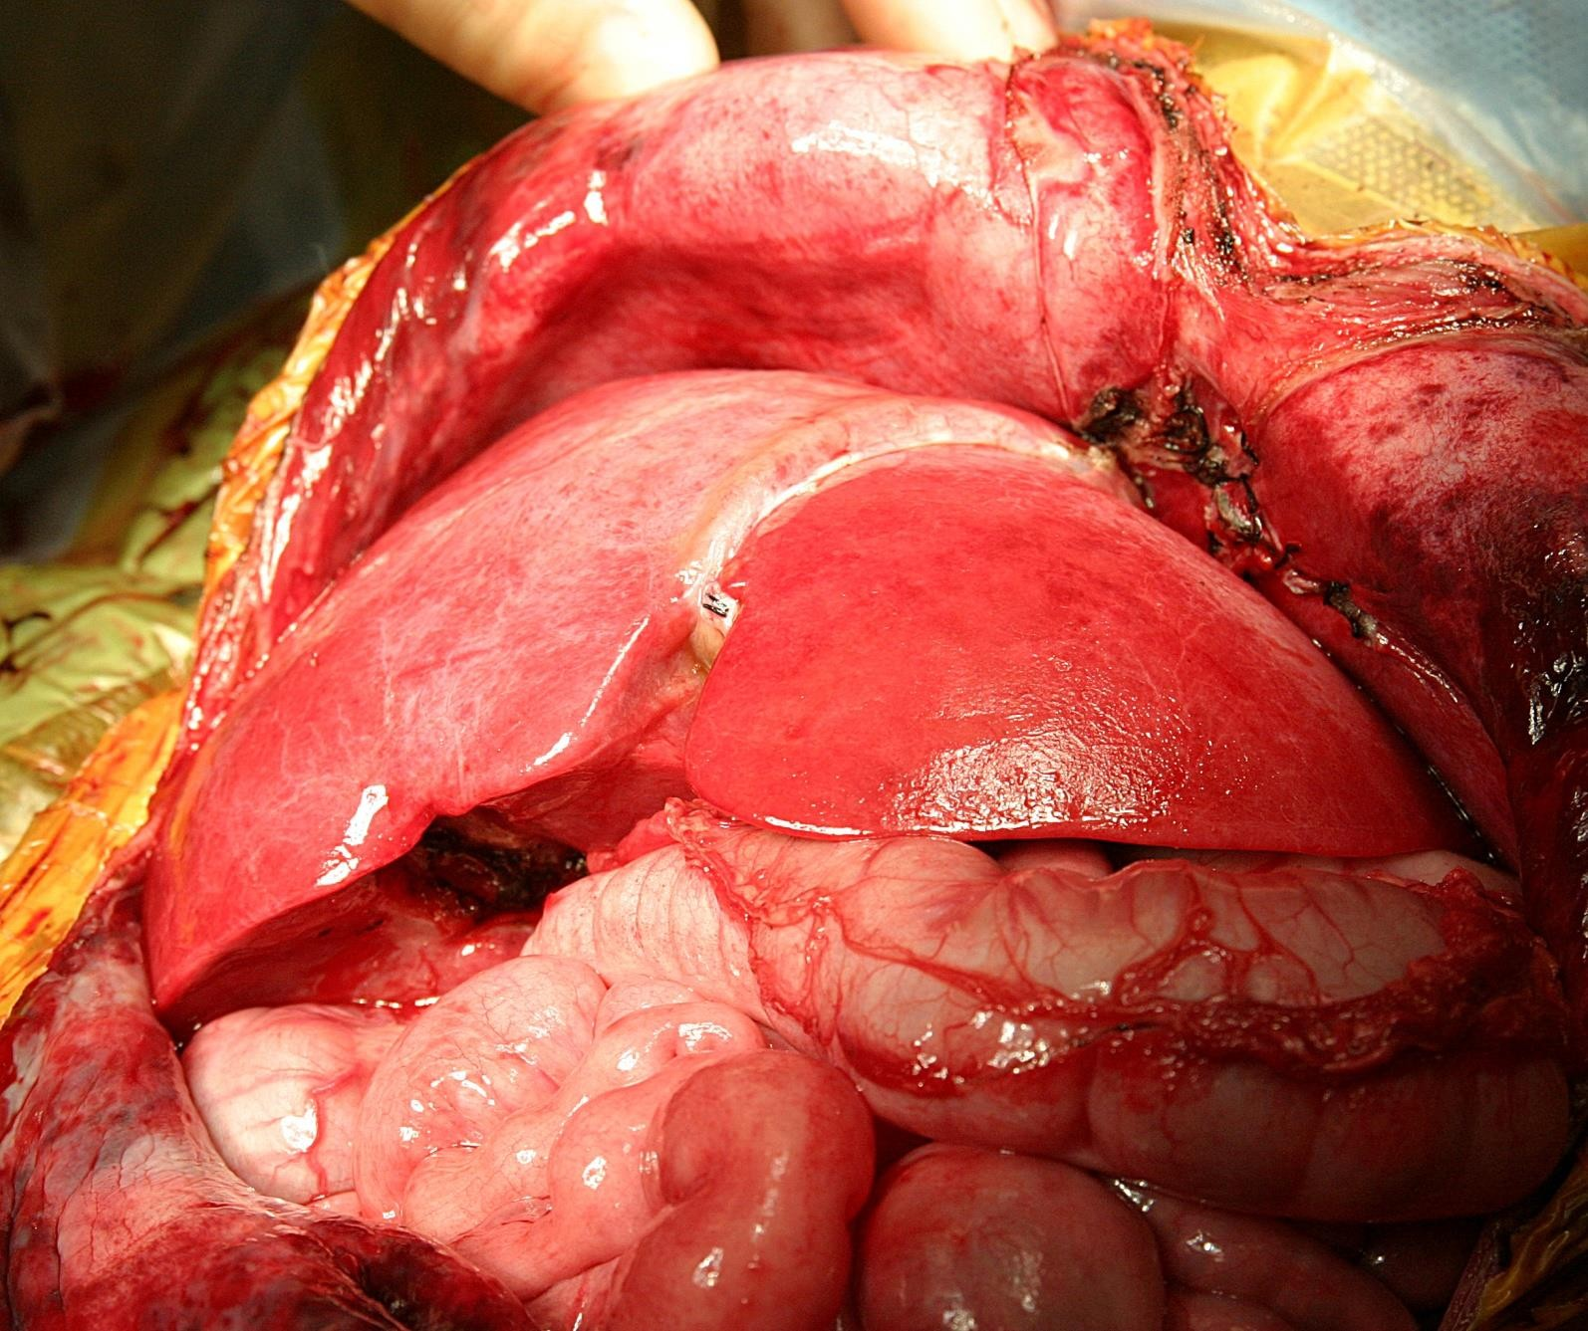
After Revascularization

Slide 18
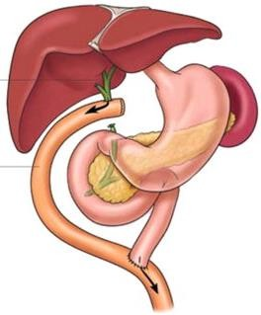
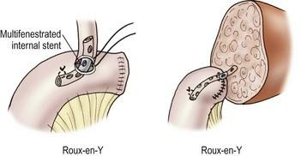
Roux-en-Y Biliary Reconstruction
Clinical Liver Disease, Vol 2, No 4, August 2013
Ryckman F. Liver transplantation. In: Ziegler MM, Azizkhan RG, Weber T, editors. Operative Pediatric Surgery. New York: McGraw-Hill; 2003. p. 1275.

Slide 19
At the end
Improved technical variant allografts have decreased waiting list mortality and maximized organ utilization in pediatric liver transplantation
Close collaboration between transplant surgeon , nutritionist, GI man, Radiologist … is necessary to ensure optimal pediatric liver transplant outcomes

Slide 20
Thank you for your attention
Questions?

